Slide 1
CAAPB Pawg Neeg Tawm Tswv Yim txog Kev Sib Koom Tes Nrog Cov Pej Xeem
Qauv Vaj Tse ib cheeb tsam ntawm Lub tsev Dawb thiab Pawg Neeg Npaj Tswv Yim

Slide 2
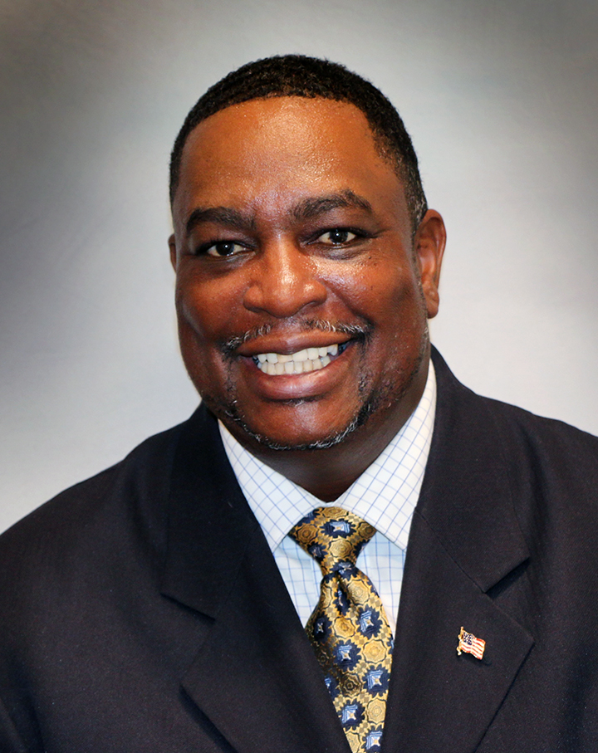
Zoo siab tos txais los ntawm tus tswj Chair Carl Crawford
“Kuv zoo siab heev los tos txais koj thiab ua tsaug qhov koj yog ib feem ntawm qhov hauj lwm tseem ceeb no. Peb lub hom phiaj yog tsim ib qho chaw rau cov pej xeem los qhia txog qhov lawv keev pom dua txog tias lub tsev Dawb Capitol muaj nuj nqis li cas rau lawv, muab kom tau lawv cov kev xav, daim phiaj zeb tsa nco txog tej yam dabtsi, tej yam tau ua tag los kom txhob hnov qab, thiab tej yam txhim kho ib puag ncig ntawm lub tsev Dawb Capitol. Cov tswv yim kev xav es koj qhia rau peb yuav yog cov es muaj nuj nqis rau pawg neeg CAAPB thaum peb pib ua peb qhov hauj lwm tseem ceeb ntxiv mus. Ua tsaug. Peb tos ntsoov koj cov kev xav txhab ntxiv.”

Slide 3
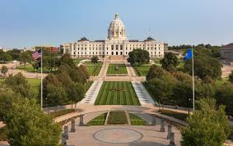
Leej twg yog tus txiav txim siab txog daim phiaj zeb tsa nco txog tej yam dabtsi, tej yam tau ua tag los kom txhob hnov qab, thiab cov duab (art) ntawm lub tsev Dawb Capitol?
Qauv Vaj Tse ib cheeb tsam ntawm Lub tsev Dawb thiab Pawg Neeg Npaj Tswv Yim yog pab neeg txiav txim siab.
Pawg neeg (Board) muaj kaum ob leeg thiab tswj los ntawm tus lwm thawj Lieutenant Governor.
Cov pawg neeg no yog cov pej xeem thiab tsoom fwv hauv lub xeev state legislators es raug xaiv ua hauj lwm 4 xyoos.
Thaum lub Xya hli xyoo 2020, nws tsim ib pawg neeg Tawm Tswv Yim txog Kev Sib Koom Tes Nrog Cov Pej Xeem kom pab mloog cov kev xav ntawm cov pej xeem thoob plaws hauv lub xeev Minnesota
Saib mus rau lub tsev Dawb Capitol Mall

Slide 4
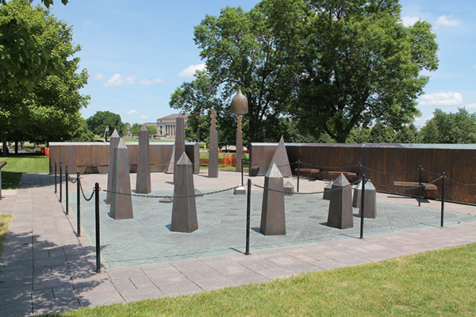
Vim li cas thiaj li nug kuv kom los koom qhov kev sib tham hnub no?
Pawg neeg Tawm Tswv Yim txog Kev Sib Koom Tes Nrog Cov Pej Xeem xav hnov txog seb koj xav li cas.
15 tus neeg ntawm pawg neeg tswj qhov hauj lwm no yog los mloog cov pej xeem hauv lub xeev Minnesota.
Peb xav hnov koj cov tswv yim thiab qhov muaj nqis ntawm lub tsev Dawb Capitol.
Peb qhov kev sib tham hnub no yeej muaj ntau zaus rooj sib tham zoo ib yam es yuav tshwm sim ua ntu zus ntawm xyoo no.
Lub hom phiaj yog kom txhua tus paub meej tias txhua tus pej xeem hauv lub xeev Minnesota kom lawv xav tias lawv raug tos txais zoo ntawm lub tsev Dawb Capitol.
Qhov chaw nco txog The Roy Wilkins Memorial ntawm lub tsev dawb Capitol Mall

Slide 5
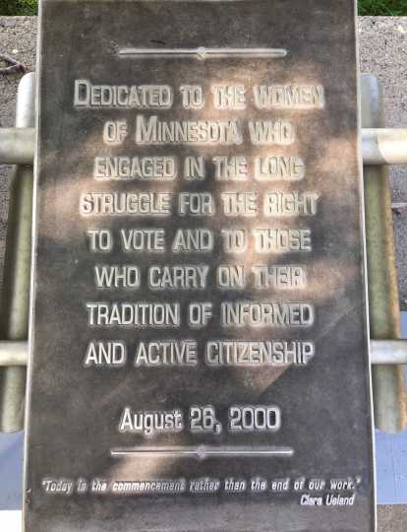
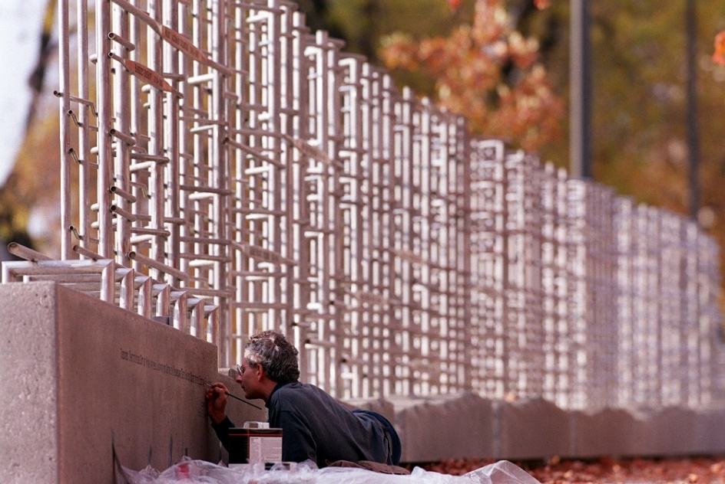
Kuv cov tswv yim txhab ntxiv no yuav muab siv li cas?
Nws yuav yog ib feem ntawm cov tswv yim qhia tawm mus rau CAAPB. Daim ntawv qhia tawm…
Yuav muaj cov niam tswv yim (theme) es hais tawm los ntawm cov kev sib tham es peb muaj.
Yuav muab qhov kev xav tias ua li cas thiaj li zoo rau pawg neeg Board txog:
Yuav ua cas es cov pej xeem thiaj paub tias CAAPB yog dabtsi thiab lawv qhov kev txiav txim siab yog li cas
Yuav ua cas pawg neeg CAAPB thiaj li pub cov pej xeem koom nrog lawv qhov kev txiav txim siab
Daim lag zeb nco txog cov poj niam raug cais txog kev pov npav (Minnesota Woman Suffrage Memorial) ntawm tsev Dawb Capitol Mall

Slide 6
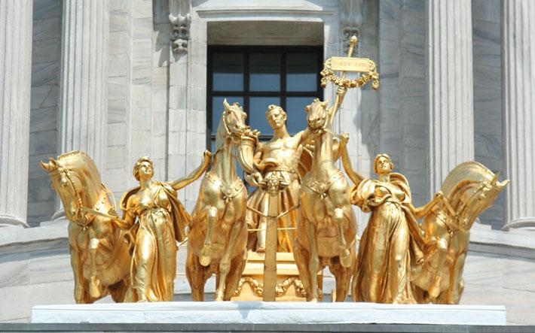
Yuav ua li cas kuv thiaj li paub tias kuv cov tswv yim txhab ntxiv muab coj los xav?
Peb yeej sau cov tswv yim ntawm rooj sab laj hnub no cia
Koj yuav teb ib daim ntawv nug (survey) thaum lub caij sib tham no thiab
Thiab peb yuav siv lub email koj muab rau peb thaum cuv npe ua ntej los yog cov lus teb ntawm daim ntawv nug survey los qhia tawm thaum twg peb tiav lawm.
Ib qho kom nco qab, peb tsis yog cov txiav txim siab – qhov ntawd yog pawg neeg CAAPB.
Peb tsuas yog, siv koj cov tswv yim txhab ntxiv qhia rau pawg neeg CAAPB kom lawv muab cov tswv yim ntawm cov pej xeem los mloog thaum txiav txim siab
Quadriga sab saum qhov rooj nkag mus rau lub tsev Dawb Capitol

Slide 7
Cov npe ntawm cov duab (Arts)
Lub tsev Dawb hauv lub xeev qhov chaw muaj cov keeb kwm (State Capitol Historic Site) txhais txog cov keeb kwm ntawm lub tsev Dawb Capital thiab tsoom fwv hauv lub xeev, cov keeb kwm thaum ub thiab cov tam sim no. Lub tsev Dawb Capital qhia txog cov txheej txheem ntawm kev kav teb kav chaw (political process) thiab qhia kom cov pej xeem xav los koom nrog rau tsoom fwv.
Lub chaw ceev qub txeeg qub teg hu ua MN Historical Society muaj cov npe teeb qhia tag nrho ntawm cov duab (artwork) nyob hauv lub tsev ntawm lawv lub vas sab:
Cov npe teeb qhia txog cov duab| Minnesota Historical Society (mnhs.org)

Slide 8
Kev sib tham – Kab lus nug #1
Yav tag los thaum koj tuaj ntawm lub tsev dawb Capital, koj xav li cas xwb? Yog tias koj tsis tau tuaj ntawm lub tsev dawb Capital dua li, koj xam pom li cas txog lub tsev Dawb Capital?

Slide 9
Kev sib tham – Kab lus nug #2
Lub tsev Dawb Capitol puas muaj tej yam sawv cev rau koj lub zej zog?

Slide 10
Kev sib tham – Kab lus nug #3
Yam dabtsi es lub tsev Dawb Capitol yuav tsum tau hloov? Yam dabtsi yuav tsum cia nws nyob twj ywm li qub?

Slide 11
Kev sib tham – Kab lus nug #4
Qhov kev saib kom muaj nuj nqis twg es koj xav kom pawg neeg tswj Qauv Vaj Tse ntawm Lub tsev dawb thiab Pawg Neeg Npaj Tswv Yim siv thaum lawv txiav txim siab txog daim phiaj zeb tsa nco txog tej yam dabtsi, tej yam tau ua tag los kom txhob hnov qab, thiab cov duab (art) ntawm lub tsev Dawb Capitol?

Slide 12
Kev sib tham – Kab lus nug #5
Yam dabtsi thiaj li yuav ua rau koj xav tuaj ncig saib thiab txaus siab rau lub tsev Dawb Capitol?

Slide 13
Daim ntawv nug (Survey)
Daim ntawv nug Outreach and Engagement Survey

Slide 14
Rov qab xav txog cov lus tham thiab Cov Lus Nug

Slide 15
Ua Tsaug!
Qauv Vaj Tse ib cheeb tsam ntawm Lub tsev Dawb thiab Pawg Neeg Npaj Tswv Yim

