Slide 1
CAAPB Advisory Task Force on Public Engagement
Capitol Area Architectural and Planning Board

Slide 2
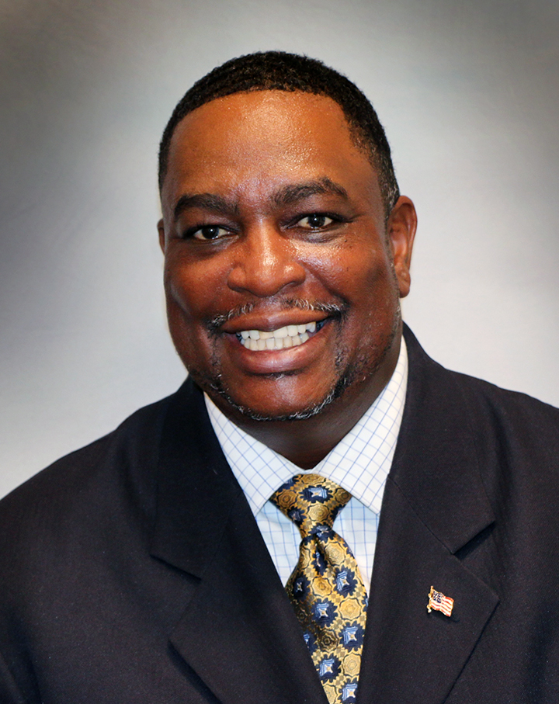
Welcome from Chair Carl Crawford
"I'm very excited to welcome you and thank you for being a part of this important work. Our purpose is to create space for the members of the public to share experiences about what the Capitol means to them, gather their feedback, monuments, memorials, and works around the Capitol grounds. Your information will provide meaningful input to the CAAPB as we will continue our important work. Thank you. We look forward to your input."

Slide 3
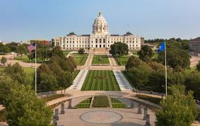
Who makes decisions about monuments, memorials, and art on Capitol Mall?
The Capitol Area Architectural and Planning Board is the decision-making body.
The Board has twelve members and is chaired by the Lieutenant Governor.
Its members are public citizens and state legislators that serve 4-year terms.
In July of 2020, it created the Public Engagement Advisory Task Force to help it hear from Minnesotans across the state.
A view of the Capitol Mall

Slide 4
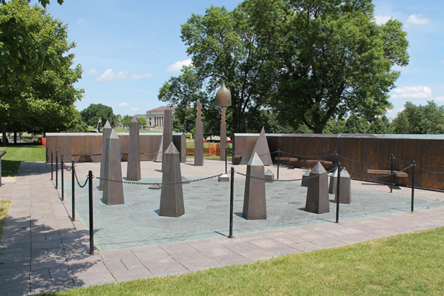
Why have I been asked to participate in today’s meeting?
The Public Engagement Advisory Task Force would like to hear what you think.
The 15-member Task Force is focused on hearing from Minnesotans.
We want to hear from you about your ideas and values about the Capitol.
Our conversation today is one of many like it that are happening this year.
The goal is to make sure all people Minnesotans feel welcome at the Capitol.
The Roy Wilkins Memorial on the Capitol Mall

Slide 5
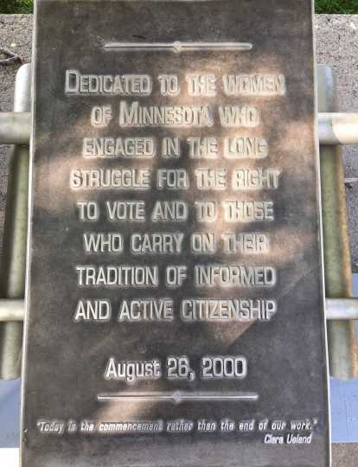
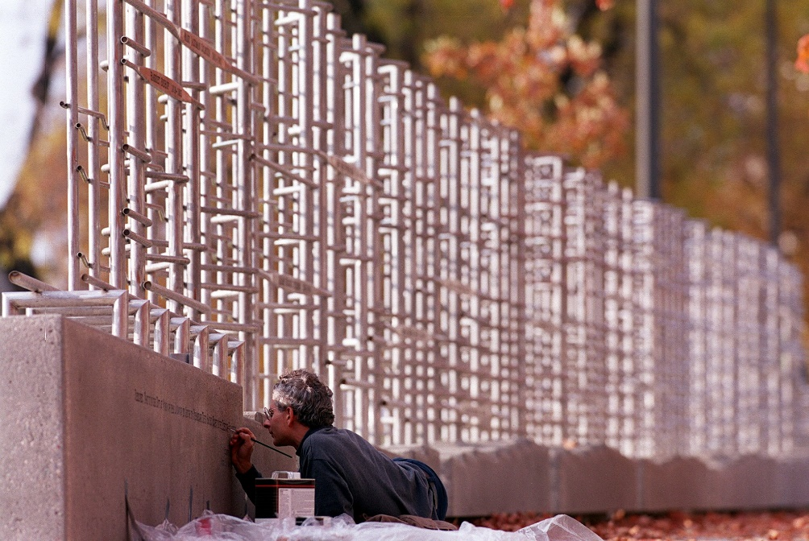
How will my input be used?
It will be part of a report to the CAAPB. The report…
Will include themes that emerge in the conversations we’re having.
Will provide recommendations to the Board about:
How to make sure the public knows what the CAAPB is and how it makes decisions
How the CAAPB can include the public in its decision making
Minnesota Woman Suffrage Memorial on the Capitol Mall

Slide 6
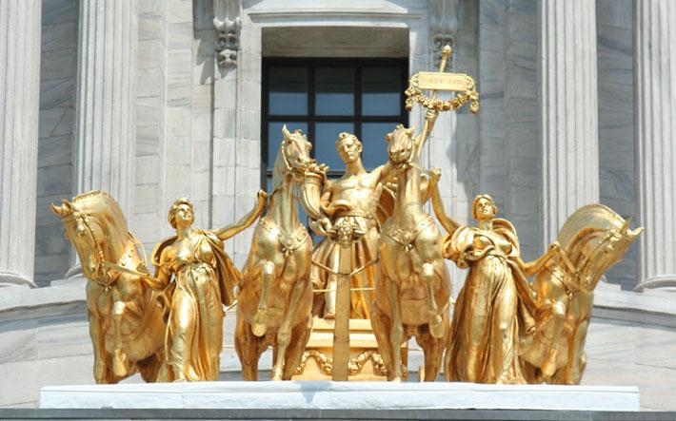
How will I know that my input has been considered?
We’re taking notes during today’s meeting
You will take a brief survey during the meeting as well
And we will use the email you provided us in the pre-registration or the survey to share our report once it’s completed
As a reminder, we aren’t making decisions – that’s the CAAPB.
Instead, we’re using your input to recommend ways for the CAAPB to better incorporate the public in its decisions
Quadriga above the entrance to the Capitol

Slide 7
List of Arts
The State Capitol Historic Site interprets the history of the Capitol and state government, both historical and current. The Capitol teaches the political process and inspires citizen participation in government.
The MN Historical Society has a listing of all artwork in the building on their website:
List of the Art | Minnesota Historical Society (mnhs.org)

Slide 8
Discussion – Question #1
What have your experiences at the Capitol been like for you? If you haven’t been to the Capitol, what is your perception of the Capitol?

Slide 9
Discussion – Question #2
Does the Capitol reflect your communities?

Slide 10
Discussion – Question #3
What at the Capitol needs to change?
What should remain the same?

Slide 11
Discussion – Question #4
What values would you like the Capitol Area Architectural and Planning Board to use when making decisions about monuments, memorials, and works of art at the Capitol?

Slide 12
Discussion – Question #5
What would make you more likely to visit and enjoy the Capitol?

Slide 13
Survey
Outreach and Engagement Survey

Slide 14
Reflections and Questions

Slide 15
Thank You!
Capitol Area Architectural and Planning Board

